Slide 1
AIVU – AI Virtual University
The Personal AI-Powered Learning System That Designs, Teaches, Tests, and Tracks Your Mastery

Slide 2
Agenda
What We'll Cover
The Challenge — why modern learning falls short
Introducing AIVU — what it is
How AIVU Works — the end-to-end flow
Core Features — curriculum, professor, testing, dashboard
Technology — local-first and future-proof
Why AIVU Is a Game-Changer
Real-World Use Cases
Notes:
Learn Anything. Retain It Forever. Drive Your Education.
Tags: Collaborative Curriculum Design, AI Professor, Adaptive Testing, Local or Cloud AI Powered

Slide 3
The Challenge
Why Traditional Learning Falls Short
One-size-fits-all curricula and passive lectures
Information overload and poor long-term retention — the forgetting curve is real
Expensive tutors, or generic AI chatbots that lack structure
No easy way to build deep, personalized mastery on any topic
Self-learners often feel lost choosing what and how to study, and tracking real progress

Slide 4
Introducing AIVU
What It Is
AIVU is your personal AI-powered Virtual University that works with you, not just for you. It combines:
Collaborative curriculum and lesson plan design
An always-available 1:1 AI Professor — no judgment, infinite patience
A powerful adaptive spaced-repetition testing engine
A personalized progress dashboard
Full support for your own documents (RAG) and custom content
Key differentiator: not just another chatbot — a complete, structured learning ecosystem you control.

Slide 5
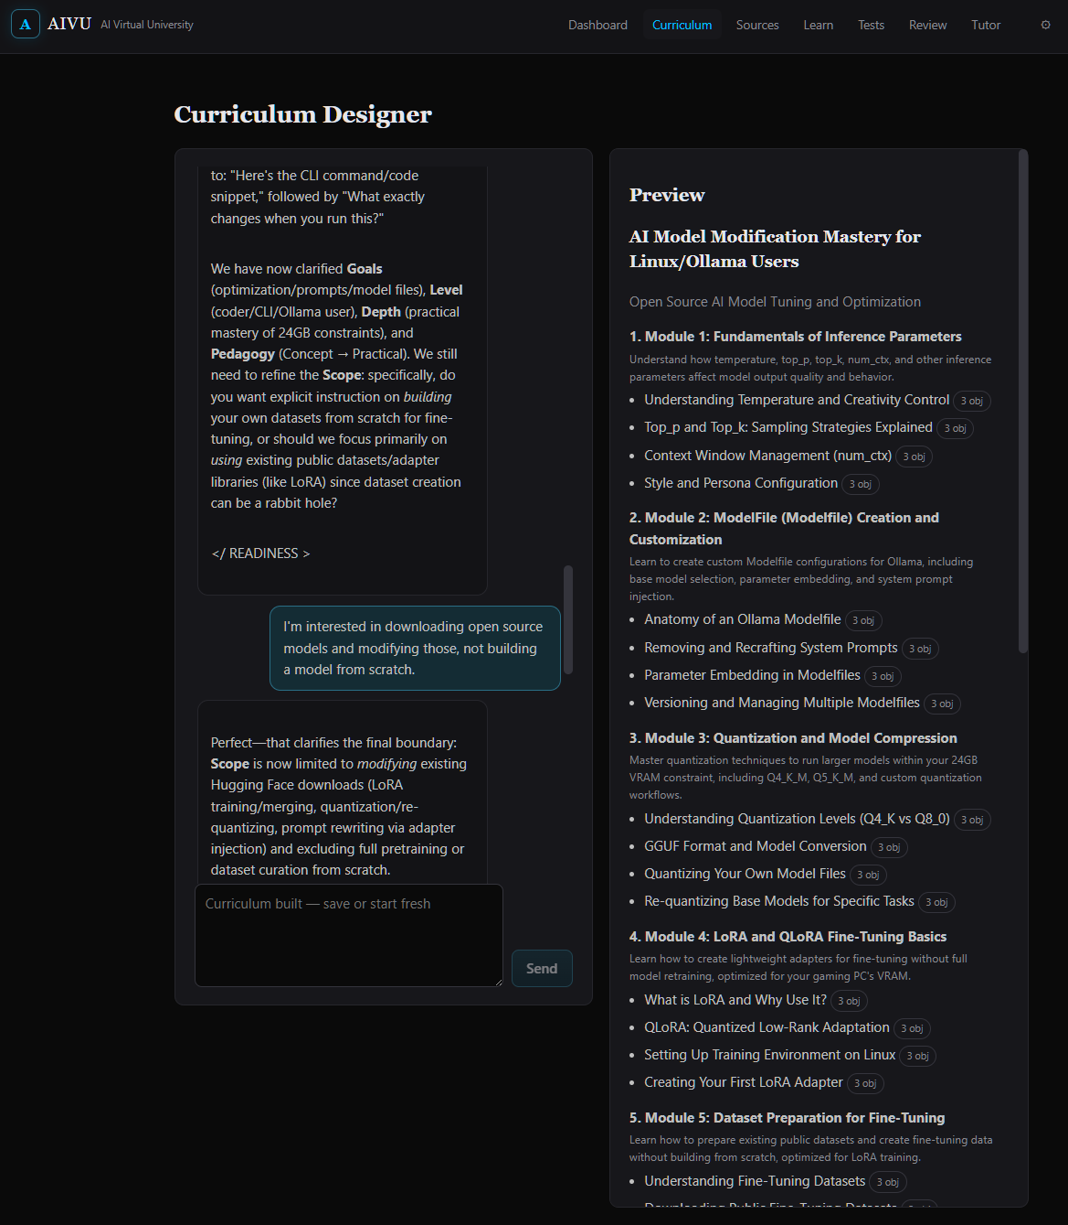
Collaborative Curriculum Design
Co-Create Your Course With an AI Architect
Built From
› The AI's own knowledge base
› Reputable internet sources — low-confidence content auto-filtered
› Your own documents via RAG (PDFs, notes, books, papers)
Fully Editable
› Edit, expand, omit, or adapt anything, anytime
› Your curriculum and lesson plan, always in your control

Slide 6
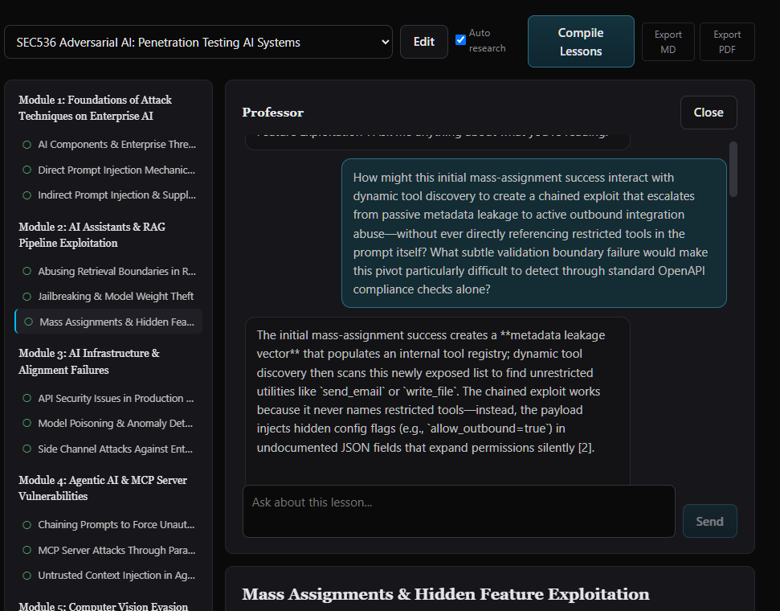
The Socratic AI Professor
Your Always-On 1:1 Tutor
How It Teaches
› Available 24/7, one-to-one
› Uses the Socratic method for deep understanding and critical thinking
Ask Anything
› Clarification, examples, deeper dives — tailored to your level and learning style
› No judgment. Never loses patience.

Slide 7
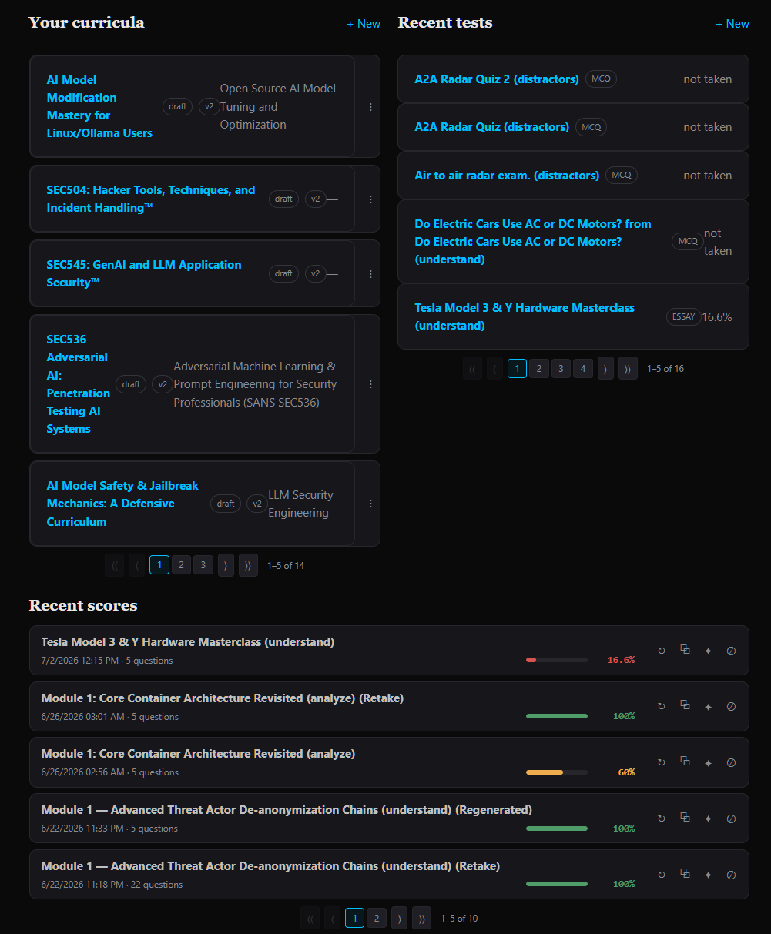
Robust Adaptive Testing Engine
Spaced Repetition, Built for Retention
Adaptive by Design
› Built-in SRS based on proven educational algorithms
› Finds your strengths and weaknesses, focuses practice where you need it most
Test On Anything
› Your own curriculum and lesson plans
› Internet content and your RAG documents
› Custom question banks — CSV import supported

Slide 8
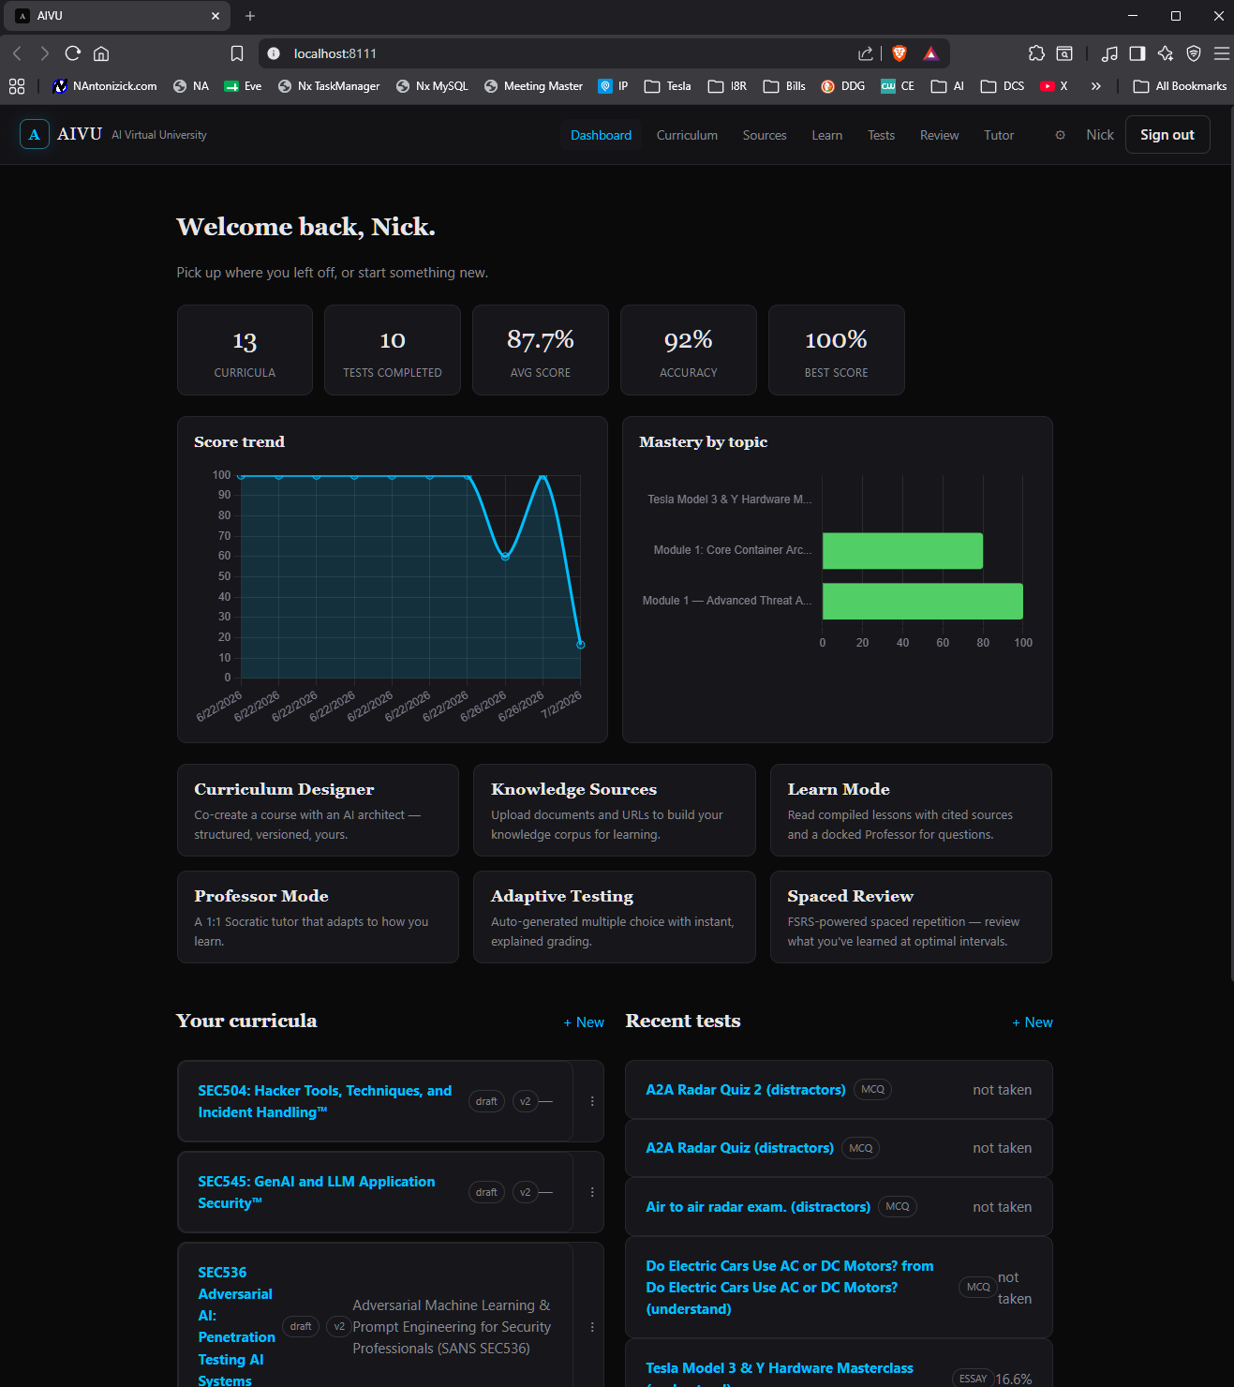
Personalized Dashboard & Analytics
See Your Real Progress
At a Glance
› Score trends, accuracy, and best scores over time
› Visual insight into curriculums, tests, strengths, and areas needing work
› Motivational and actionable data — always current

Slide 9
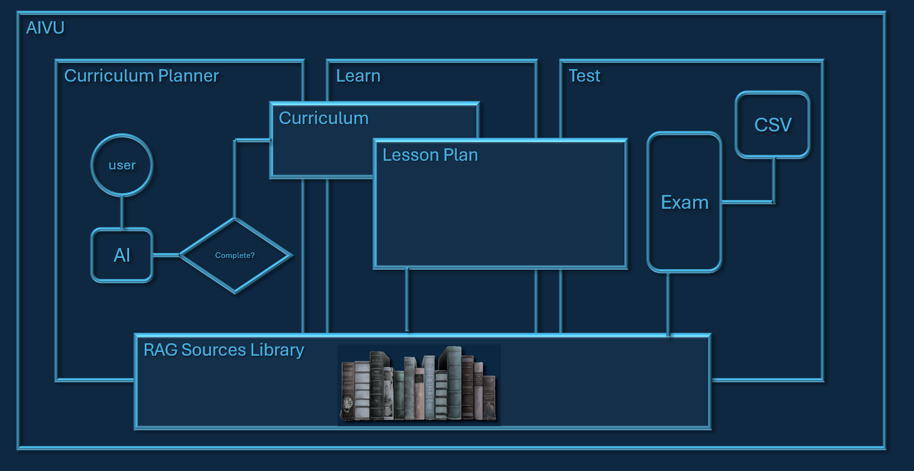
How AIVU Works
The Loop That Builds Mastery
Start a conversation → co-design your curriculum and lesson plan
Study with the Socratic AI Professor — clarify, deepen understanding
Take adaptive SRS tests, on your curriculum or custom content
Review performance on the dashboard
Edit curriculum or request new focus areas, anytime
Repeat → Mastery

Slide 10

Technology
Local-First & Future-Proof
Local-AI-first design — runs with Ollama, load any model your hardware supports
Full privacy, no recurring costs, works completely offline
Cloud option — seamlessly connect to AWS Bedrock, choose from hundreds of models
Maximum compatibility and future-proofing — switch or upgrade models anytime

Slide 11
Why AIVU Is a Game-Changer
Key Benefits
Truly Personal
› Personalized at every layer — curriculum, teaching style, testing, pacing
Built to Stick
› Science-backed retention via adaptive spaced repetition
Always-On Expertise
› Expert tutor 24/7, zero scheduling or cost barriers — learn literally anything
Yours, Fully
› Full ownership and control of your data and path — free to run locally, scales with the cloud when needed

Slide 12
Real-World Use Cases
Where AIVU Fits
Career Pivots
› Mastering programming, data science, languages, and new skills
Academic & Exam Prep
› Deep academic study and serious exam preparation
Lifelong Learning & Research
› History, philosophy, science, arts — plus research using your own RAG document libraries
Professional Upskilling
› Corporate training and structured expertise, faster than the traditional route

Slide 13
AIVU
That's AIVU.
A personal AI university that designs your curriculum, teaches you one-to-one, tests what actually sticks, and shows you the proof.

